Slide 1


Ada County Drainage District #3
Compliance
Readiness Check-in
`
Notes:
Monthly - Jan

Slide 2
1
Introduction
Legislative updates
Your compliance scorecard
Understanding your Streamline Plan
Today’s
Agenda
2
3
4

Slide 3

Your dedicated success manager
Your Compliance & Success Manager
Yenni Herschelman
I am here to ensure that Streamline meets your needs and that you are fully compliant with ever-changing state and federal laws.
Annual site reviews
Need a new feature?
Need a new site or portal?
New tools coming out

Slide 4
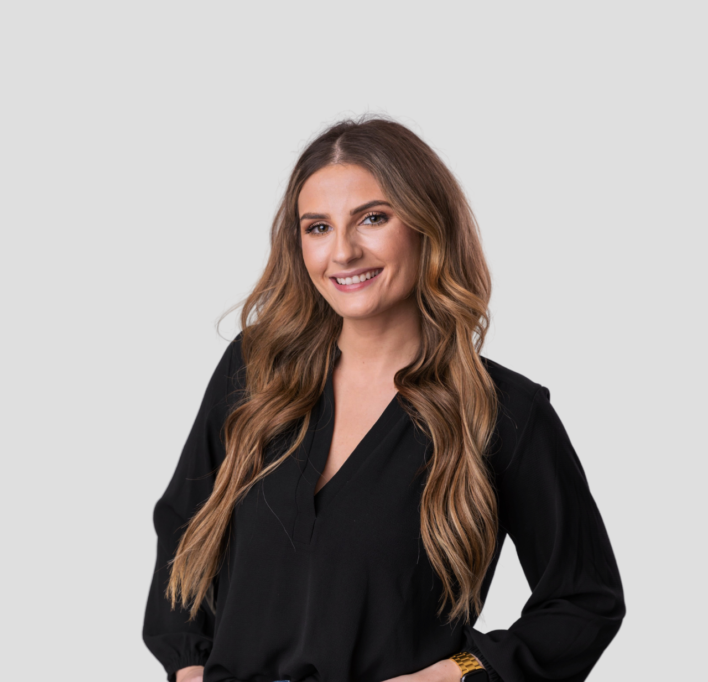

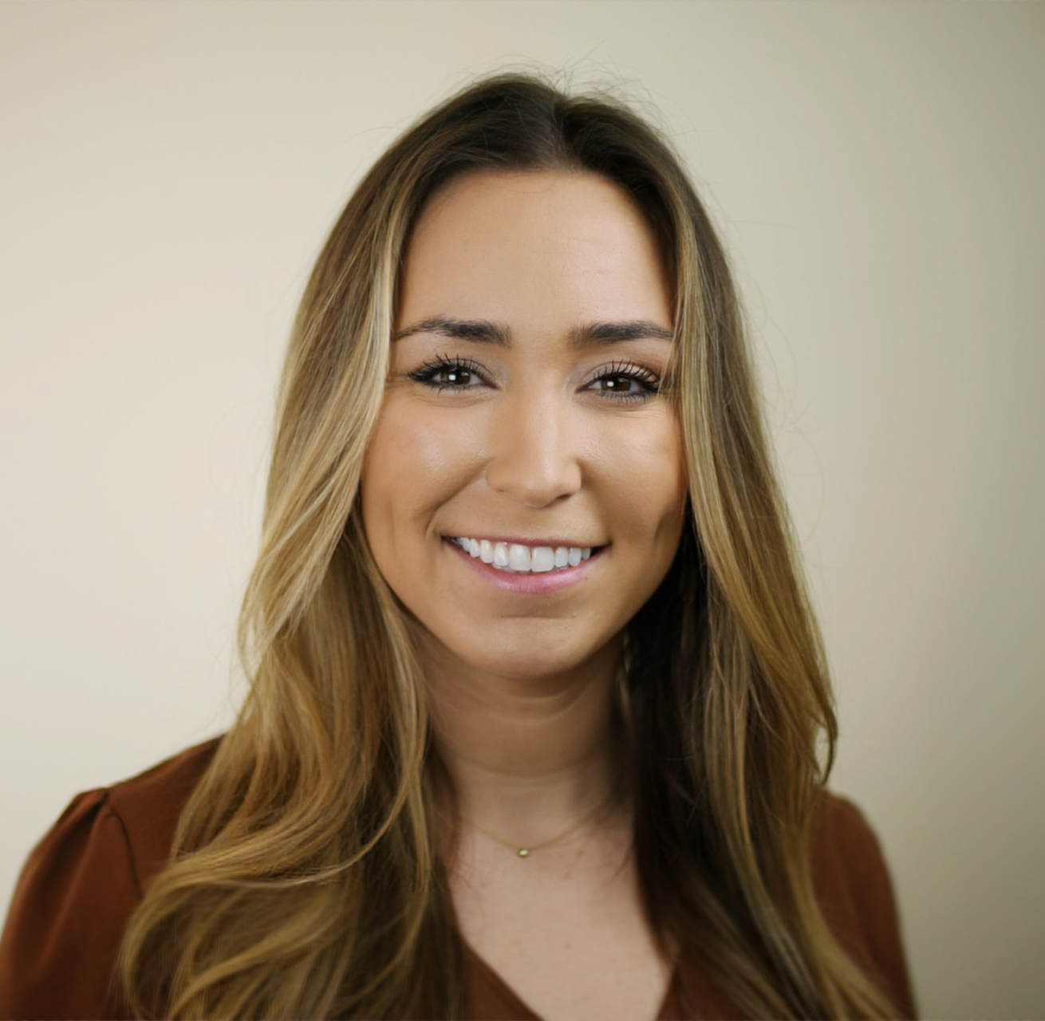

Part of a larger support team
Your Technical Support
Kurt Danilson
Bug? Question? Problem? Idea to improve? I’m your guy.
Your Compliance & Success Manager
Hannah Holmes
I am here to ensure that Streamline meets your needs and that you are fully compliant with ever-changing state and federal laws.
Your Education & Training
Madison Wallace
I’m here for your education, training, billing issues, and site reviews. Book a training with me anytime!
We’re just a click away! ⇒

Slide 5
Special District Legislation Updates for ADA
New ADA Rules Released by DOJ
Old vs. New Requirements
Why Does This Matter?
1
2
3
Notes:
Here’s a quick look at what I plan to cover today – the bulk of the time I want to talk about the endpoint management space, your priorities, and how we can help bring you value. Does that sound good?
Great. Let's start with some quick introductions. Can each of you tell me a little bit about your role at <blank company> and how you currently work with Recast?
Is there anyone else that uses Recast at <blank company> that I should know?
Are there any other contacts or departments that I should be working with to automate processes?
Do you work with any outside consultants or partners to assist with Config Manager?
If we add or change services on your account, how does that process usually work and who all is involved? Should I connect with any of those people?

Slide 6
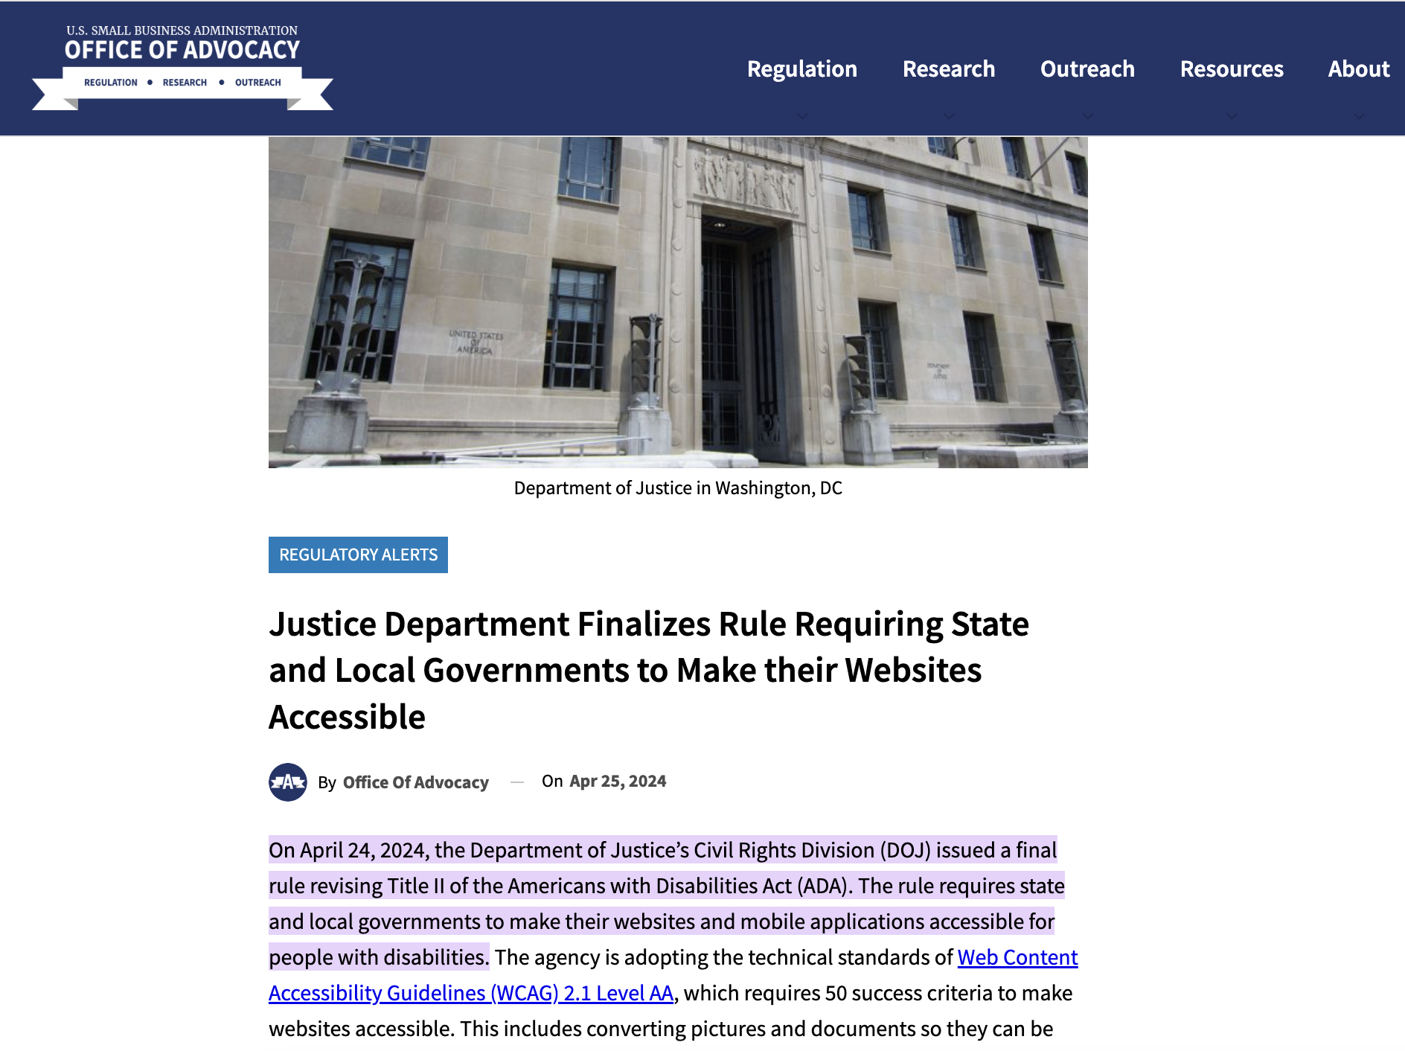

ADA compliance suddenly got harder
Department of Justice rolled out sweeping new rules in May 2024 that will be enforced on all special districts
The rules go beyond the website and call for document standards, accessibility policies, remediation methods, and more.

Slide 7
What has changed?
OLD ADA REQUIREMENTS
Checking all HTML pages for conformance to ADA compliance requirements using tool like Lighthouse
Technical support for reported issues
NEW DOJ AND STATE REQUIREMENTS
Automatically checking all PDFs for ADA compliance using industry scanner
Creating a process and remediation request form for PDFs created and placing remediation language on all pages where the PDFs are linked
Checking all videos, if present, for closed captioning and automatically enabling it
Manual testing by users with various disabilities, with testing processes documented
Generating and posting an accessibility statement and updating each year
Creating a reliable remediation form for accessibility issues that is monitored by technical personnel and CC’s district staff with two alternative forms of communication (web and non-web based).
Ongoing reviews by accessibility staff, who get automatically alerted of accessibility issues
Annual ADA compliance plan review
Creating court-admissible monthly ADA reports
Ongoing ADA support and training for your staff
Readiness for legal defense e.g. $10,000 - $50,000 of indemnification
Notes:
<Update slide above w/ your photo, name, and information in the blanks>
A bit about me… Again, my name is <NAME>, and I’m your Recast Account Manager.
At Recast, there’s a lot of things we can do and different ways we can provide value. My role is to help you navigate the world of Recast and make sure you’re getting the most out of what we offer.
By learning about your goals and what you’re trying to accomplish, I can give my two cents on how to get there and recommend best practices I’m seeing with other companies.
<Give quick background on yourself, fun fact, show business acumen>

Slide 8
What’s the risk?
2,403
56%
$39k
Districts have been affected by a web accessibility action. 🧑‍⚖️
Increase in the number of web accessibility lawsuits in 2022. ⬆️
Average amount for a web
accessibility claim in 2023. 💰
* Very few, if any, special district insurance policies cover the costs of web ADA issues.
Notes:
Add legal foundations slide/pyramid

Slide 9
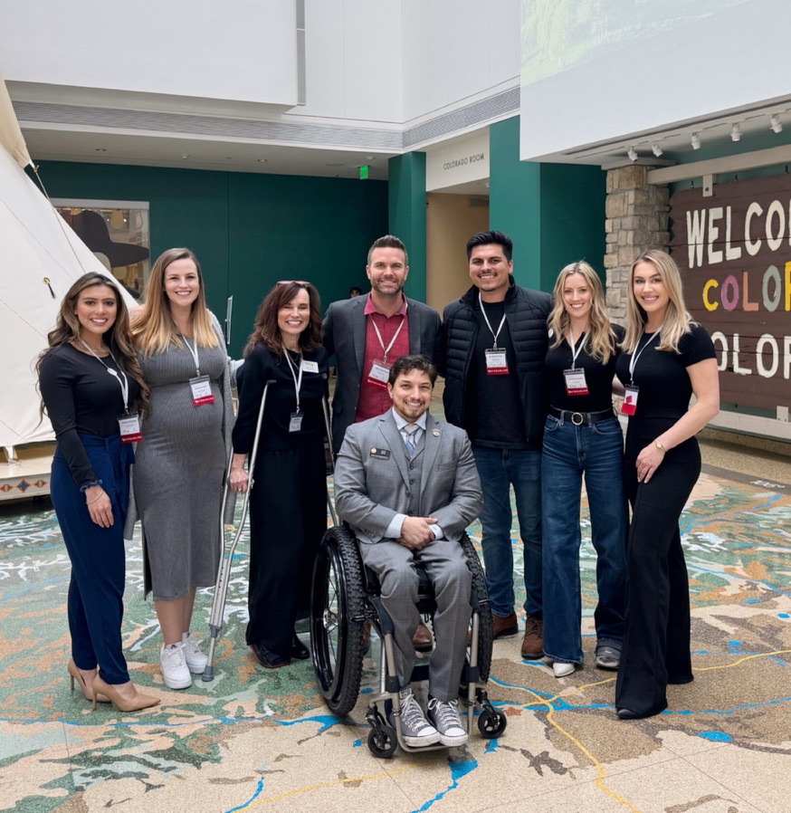
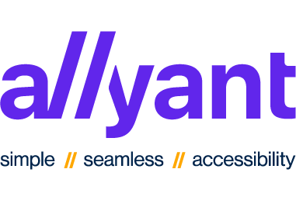

But we’ve got your back.
We partnered with Allyant CommonLook for PDF Testing and Remediation Services
We partnered with Jeffer Mangels Mitchell and Butler for Indemnification and ADA Legal Defense
We partnered with Level Access for formal testing of your site by users disabilities
Streamline with Rep. David Ortiz at the History Colorado Center

Slide 10
Your New Streamline Plan
New features deployed to assist you with these new mandates
Notes:
Here’s a quick look at what I plan to cover today – the bulk of the time I want to talk about the endpoint management space, your priorities, and how we can help bring you value. Does that sound good?
Great. Let's start with some quick introductions. Can each of you tell me a little bit about your role at <blank company> and how you currently work with Recast?
Is there anyone else that uses Recast at <blank company> that I should know?
Are there any other contacts or departments that I should be working with to automate processes?
Do you work with any outside consultants or partners to assist with Config Manager?
If we add or change services on your account, how does that process usually work and who all is involved? Should I connect with any of those people?

Slide 11

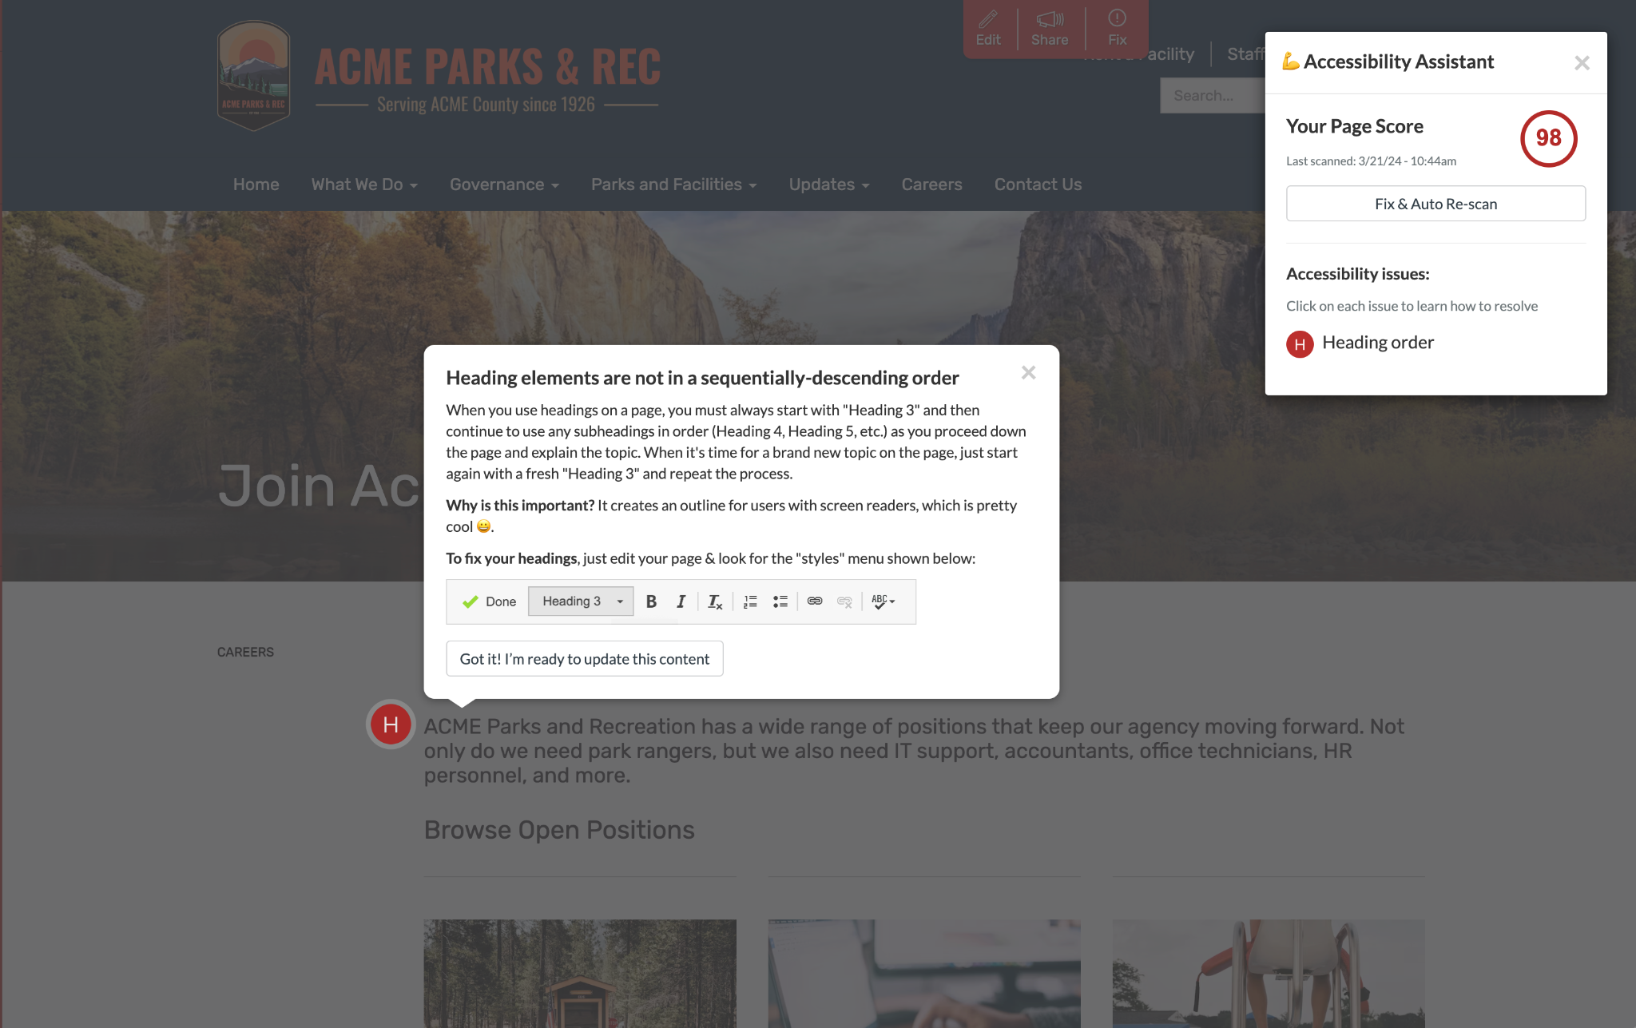
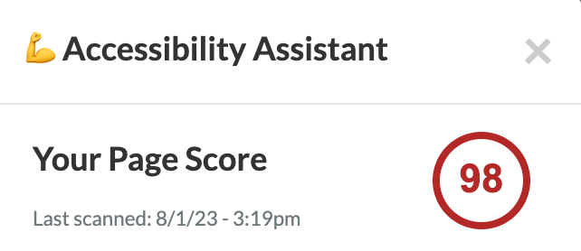
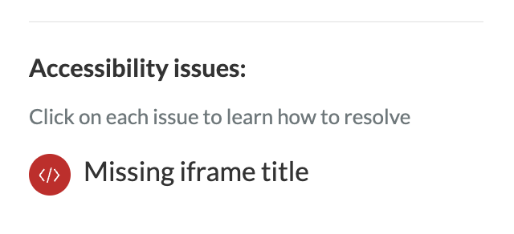

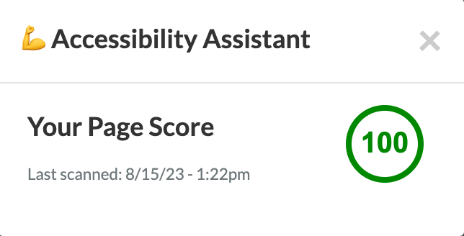
Your Accessibility Assistant guides you on how to fix issues right on page 💯

Slide 12
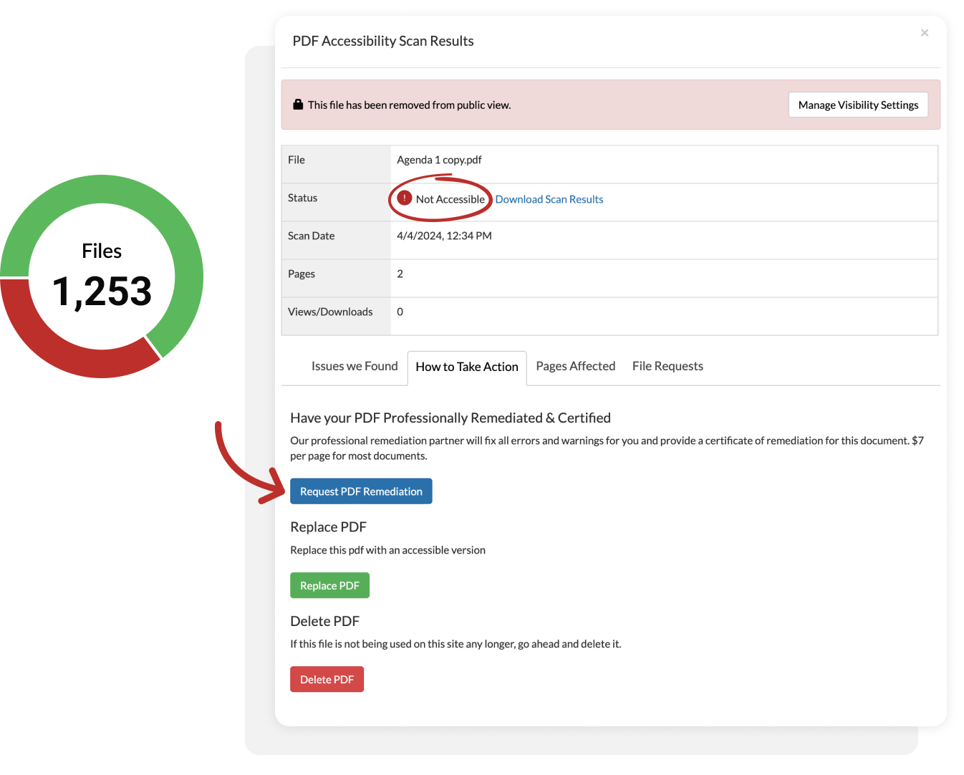
Built-in PDF remediation services and archiving for all files on your site 🙌
🚨Easily view which PDFs are not accessible
🛠Request a PDF remediation on the spot
🗂Manage and archive all PDFs on your site
💸Only $7 a page saves you money

Slide 13
Flexible New Plans built for your district’s specific needs 💪
Current Plan
$90/month
☁️ Website hosting + content management
✨Amplify™Design Builder
🗺️ Google maps + locations Integration
👍 Social feed integration
🎨 Annual design reviews
📊 Annual board reports
⚖️ Compliance & posting checklist
♿️ DOJ Required
📄DOJ Required
🛡️$10,000 indemnification from ADA issues
🗓️ Meetings assistant
📱One-click social sharing
📧 One-click email marketing & subscriptions
💰 Payments / commerce tools
🔏 E-Signature Forms
💬 Internal communications hub
⚙️ Support with integration of embedded tools
📞 Training + support
⚖️ Compliance Basics
$210/month
$175/month
☁️ Website hosting + content management
✨Amplify™Design Builder
🗺️ Google maps + locations Integration
👍 Social feed integration
🎨 Annual design reviews
📊 Annual board reports
⚖️ Compliance & posting checklist
♿️ ADA accessibility assistant
📄Access to PDF Remediation
🛡️$10,000 indemnification from ADA issues
🗓️ Meetings assistant
📱One-click social sharing
📧 One-click email marketing & subscriptions
💰 Payments / commerce tools
🔏 E-Signature Forms
💬 Internal communications hub
⚙️ Support with integration of embedded tools
📞 Training + support
🚀 Operations Pro
$700/month
$240/month
☁️ Website hosting + content management
✨🏆 Amplify™ Premium Design Builder
🗺️ Google maps + locations Integration
👍 Social feed integration
🎨 Annual design reviews
📊 Annual board reports
⚖️ Compliance + posting checklist
♿️ ADA accessibility assistant
📄Access to PDF Remediation
🛡️$50,000 indemnification from ADA issues
🗓️ Meetings assistant
📱One-click social sharing
📧 One-click email marketing & subscriptions
💰 Payments / commerce tools
🔏 E-Signature Forms
💬 Internal communications hub
⚙️ Support with integration of embedded tools
📞 Training + support
Customer Favorite 🏆
🤝 Community Pro
$300/month
$195/month
☁️ Website hosting + content management
✨ Amplify™ Design Builder
🗺️ Google maps + locations Integration
👍 Social feed integration
🎨 Annual design reviews
📊 Annual board reports
⚖️ Compliance + posting checklist
♿️ ADA accessibility assistant
📄Access to PDF Remediation
🛡️$25,000 indemnification from ADA issues
🗓️ Meetings assistant
📱One-click social sharing
📧 One-click email marketing & subscriptions
💰 Payments / commerce tools
🔏 E-Signature Forms
💬 Internal communications hub
⚙️ Support with integration of embedded tools
📞 Training + support
Disc.
Rate Guaranteed <4.8% annual max increase
Notes:
Tier 1

Slide 14

Thank You!

