Slide 1
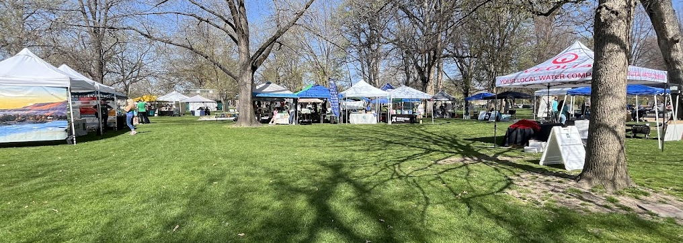
Public education/outreach q3/q4

Slide 2
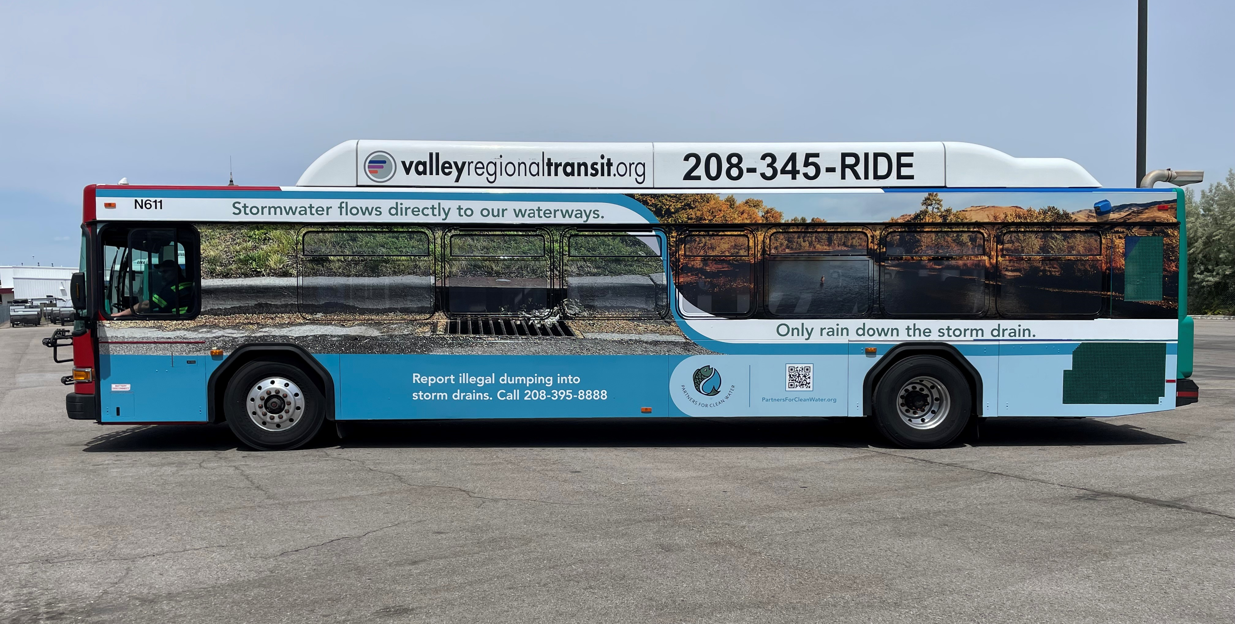
Bus wrap- Boise-Caldwell line
May, June, July, August

Slide 3
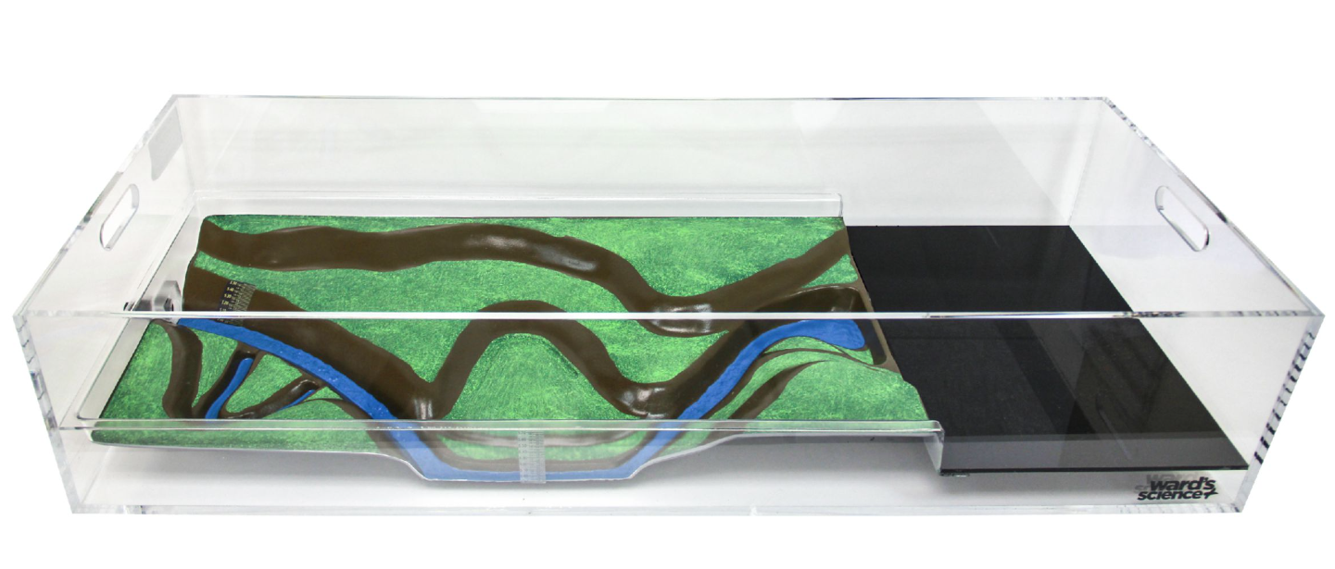
Stormwater/flood simulation model

Slide 4
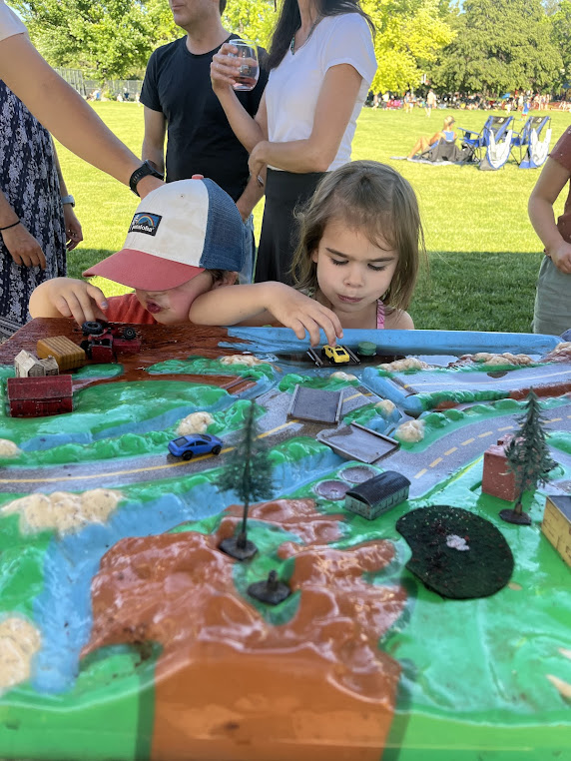
Neighborhood concert series
July 24th - Elm Grove Park
July 31st - Cypress Park
August 21st - Kristin Armstrong Park

Slide 5
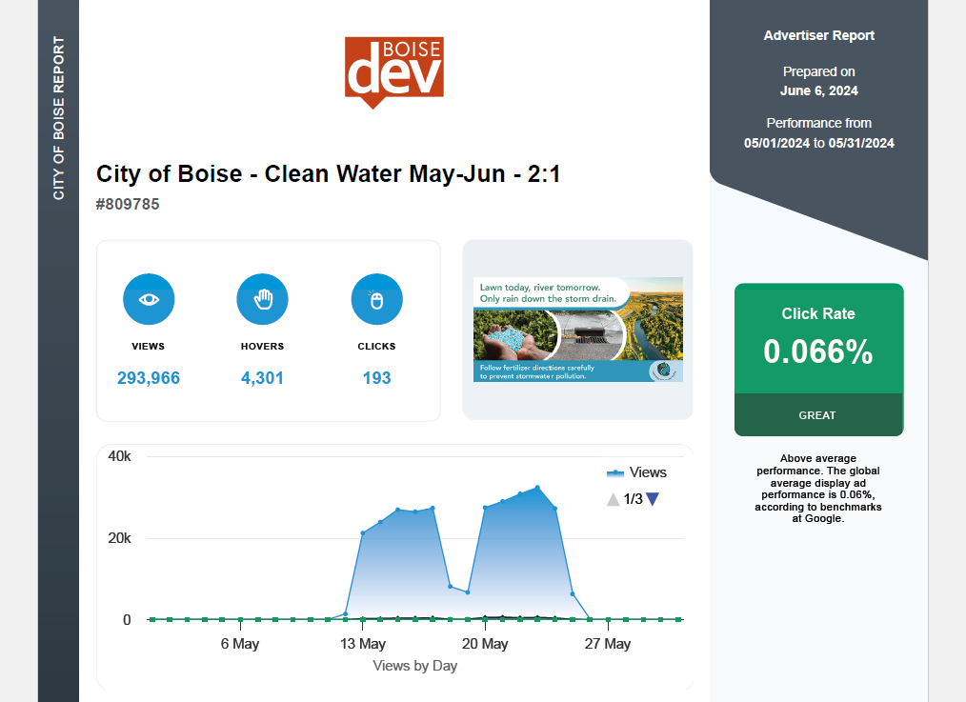

Slide 6
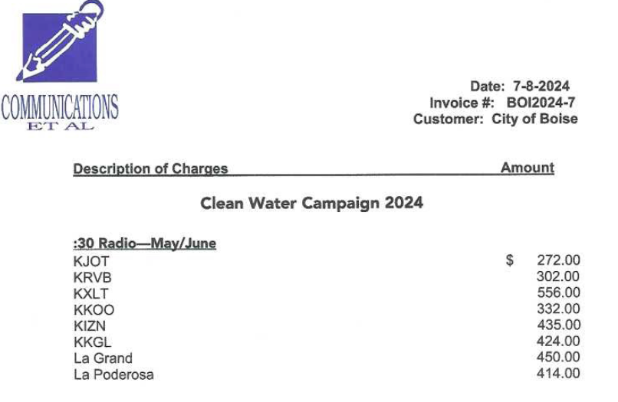

Slide 7
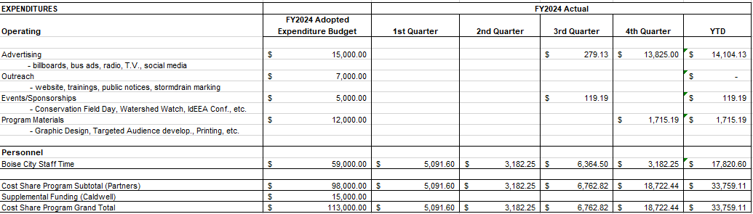

Slide 8
Upcoming events/outreach
August 2: Neighborhood Night Out- Central Rim NA
September 26th : Permanent SW Control O&M Event- Bown Library
Food truck outreach materials
O&M Manuals on GIS
Public storm drain art

Slide 9

















































































Slide 10

















































































